Slide 1
7151CEM Computing Individual Research Project
Name: Vedan Yadav Gokul
Student Id: 11479310

Slide 2
Introduction
Text classification is the task of labelling natural language texts with relevant categories from a predefined dataset [1].
Text classification has significant use various number of fields like entertainment, Academia and Government.
The data that is going to be classified in this project is Wikipedia data, which is publicly available.
The aim of the project is to compare the performance of different Machine Learning and Deep Learning techniques, reason their performance and identify the best performing techniques on Wikipedia article classification.

Slide 3
Previous works
A survey of different Machine Learning and Deep Learning methods and their performance on text classification is done in research papers [2], [3], [4] and [5]. They discuss and review the ups and downs of different methods on Natural Language Processing problems and which method suits the best for each individual task like Sentiment Analysis, Topic Classification, Question Answering and News categorization.
Research papers [6], [7] and [8] discuss about the detailed implementation of Machine Learning methods for text classification. While [9] and [10] focus on applications in languages other than English and focus on the difficulties faced and change of implementation methods and the need for new tools to explore text in languages other than English. [9] focuses on Arabic language texts while [10] focuses on Bengali Language texts.

Slide 4
Papers [11], [12] and [13] focus on Application of Deep Learning methods for Text classification tasks. While [14] and [15] give us the detailed look into some of the Hybrid models which can be used for text classification and they also reason the need for using Hybrid Models.

Slide 5
Methodology
As this project is aimed to categorize Wikipedia articles by using text classification, there are not many suitable datasets that are ready and publicly available that fit the exact scale of data and diversity of classes needed for this project. Acquiring the data and creating suitable dataset was the starting step.
Data visualization was the second step. Significant Data visualization was done to determine any underlying patterns , Outliers or trends which may help us in the future for data analysis or any peculiarities we need to be vary of.
Performing a literature review and grasping an understanding of text classification and the methods used. Their implementation and performance scale on different datasets was also taken note of.

Slide 6
The next step is figuring out the complexity of the data. Then choosing the models we want to apply on our dataset.
Appropriate data Cleaning and application of the chosen models
Analyzing the performance of the models and reasoning for the performance of a given model.
Comparing the performance of different models.

Slide 7
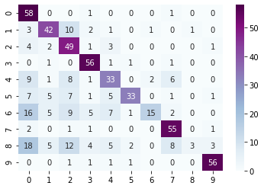
Experimental Results
Logistic Regression Validation Accuracy : 76.8 %
Confusion
Matrix :

Slide 8
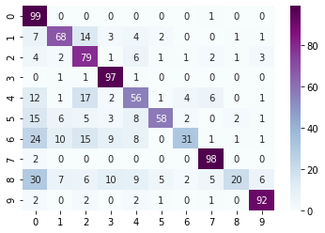
Logistic Regression Testing Accuracy : 69.8%
Confusion Matrix:

Slide 9
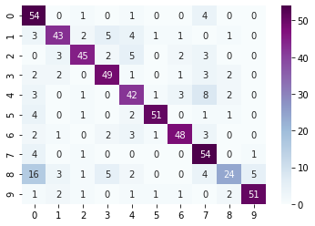
Multinomial Naïve Bayes Validation Accuracy : 77 %
Confusion Matrix:

Slide 10
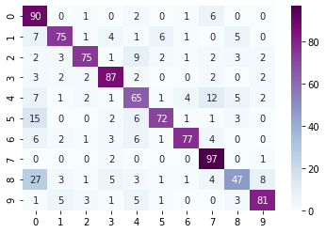
Multinomial Naïve Bayes Testing Accuracy : 76.6 %
Confusion Matrix:

Slide 11
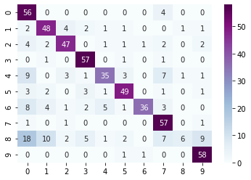
Random Forest Classifier Validation Accuracy : 74.8 %
Confusion Matrix:

Slide 12
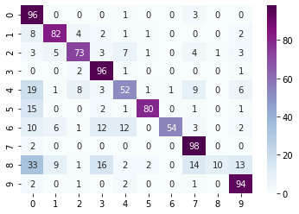
Random Forest Classifier Testing Accuracy : 73.5 %
Confusion Matrix:

Slide 13
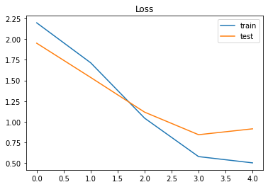
Long Short-Term Memory (LSTM) accuracy : 77.6%
Loss with Epochs:

Slide 14
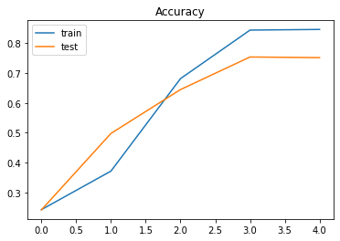
LSTM Testing Accuracy with Epochs:

Slide 15
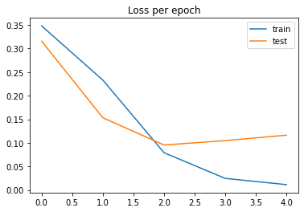
CNN accuracy : 85.8%
CNN Loss with epochs:

Slide 16
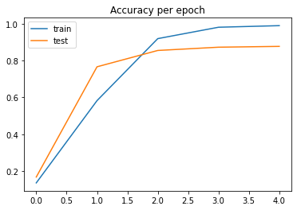
CNN Accuracy with epochs:

Slide 17
Conclusion
We applied Machine Learning models and Deep Learning models for topic classification of Wikipedia articles.
All the models performed very well. The accuracy was around 70-75% for most of the models. It was surprising to see simple models with such high accuracy performing the Wikipedia topic classification.
LSTM didn’t increase the performance on the testing set by a substantial amount as one would expect from a complex RNN technique. The reason might be due to the balanced and anomaly less dataset that we created by ourselves. The higher accuracy on the testing set of all models means that the dataset was not complex enough to make the models struggle.
The model with the highest testing accuracy was CNN with an accuracy of 85.8%. It’s performance was significantly better compared any other models. So for any future applications of topic classification on Wikipedia articles, CNN is definitely recommended accoeding to our dataset.

Slide 18
References
1. Text Classification Application and use cases- Shashank Gupta, Towardsdatascience. Feb 20 2018.
2. JinXiong Yang, Liang Bai, and Yanming Guo. 2020. A survey of text classification models. In Proceedings of the 2020 2nd International Conference on Robotics, Intelligent Control and Artificial Intelligence (RICAI 2020). Association for Computing Machinery, New York, NY, USA, 327–334. DOI:https://doi.org/10.1145/3438872.3439101
3. Shervin Minaee, Nal Kalchbrenner, Erik Cambria, Narjes Nikzad, Meysam Chenaghlu, and Jianfeng Gao. 2021. Deep Learning--based Text Classification: A Comprehensive Review. ACM Comput. Surv. 54, 3, Article 62 (April 2022), 40 pages. DOI:https://doi.org/10.1145/3439726

Slide 19
References
4. Yifan Zhou. 2020. A Review of Text Classification Based on Deep Learning. In Proceedings of the 2020 3rd International Conference on Geoinformatics and Data Analysis (ICGDA 2020). Association for Computing Machinery, New York, NY, USA, 132–136. DOI:https://doi.org/10.1145/3397056.3397082
5. Athanasios Tzimourtas, Spyros Bakalakos, Panagiota Tselenti, and Athanasios Voulodimos. 2021. An exploration on text classification using machine learning techniques. In 25th Pan-Hellenic Conference on Informatics (PCI 2021). Association for Computing Machinery, New York, NY, USA, 247–249. DOI:https://doi.org/10.1145/3503823.3503869
6. Athanasios Tzimourtas, Spyros Bakalakos, Panagiota Tselenti, and Athanasios Voulodimos. 2021. An exploration on text classification using machine learning techniques. In 25th Pan-Hellenic Conference on Informatics (PCI 2021). Association for Computing Machinery, New York, NY, USA, 247–249. DOI:https://doi.org/10.1145/3503823.3503869

Slide 20
7. Mariem Bounabi, Karim El Moutaouakil, and Khalid Satori. 2019. Text classification using Fuzzy TF-IDF and Machine Learning Models. In Proceedings of the 4th International Conference on Big Data and Internet of Things (BDIoT'19). Association for Computing Machinery, New York, NY, USA, Article 18, 1–6. DOI:https://doi.org/10.1145/3372938.3372956
8. Yasser Ali Alshehri. 2020. Text mining for incoming tasks based on the urgency/importance factors and task classification using machine learning tools. In Proceedings of the 2020 the 4th International Conference on Compute and Data Analysis (ICCDA 2020). Association for Computing Machinery, New York, NY, USA, 183–189. DOI:https://doi.org/10.1145/3388142.3388153
9. Ahmed Alsanad. 2018. Arabic Topic Detection Using Discriminative Multi nominal Naïve Bayes and Frequency Transforms. In Proceedings of the 2018 International Conference on Signal Processing and Machine Learning (SPML '18). Association for Computing Machinery, New York, NY, USA, 17–21. DOI:https://doi.org/10.1145/3297067.3297095

Slide 21
10. Rifat Rahman. 2020. A Benchmark Study on Machine Learning Methods using Several Feature Extraction Techniques for News Genre Detection from Bangla News Articles & Titles. In 7th International Conference on Networking, Systems and Security (7th NSysS 2020). Association for Computing Machinery, New York, NY, USA, 25–35. DOI:https://doi.org/10.1145/3428363.3428373
11. Bang An, Wenjun Wu, and Huimin Han. 2018. Deep Active Learning for Text Classification. In Proceedings of the 2nd International Conference on Vision, Image and Signal Processing (ICVISP 2018). Association for Computing Machinery, New York, NY, USA, Article 22, 1–6. DOI:https://doi.org/10.1145/3271553.3271578
12. Jingli Wang, Ashok Bhowmick, Mucahit Cevik, and Ayse Basar. 2020. Deep learning approaches to classify the relevance and sentiment of news articles to the economy. In Proceedings of the 30th Annual International Conference on Computer Science and Software Engineering (CASCON '20). IBM Corp., USA, 207–216.

Slide 22
13. Zhengfei Shen and Shaohua Zhang. 2020. A Novel Deep-Learning-Based Model for Medical Text Classification. In Proceedings of the 2020 9th International Conference on Computing and Pattern Recognition (ICCPR 2020). Association for Computing Machinery, New York, NY, USA, 267–273. DOI:https://doi.org/10.1145/3436369.3436469
14. Min Yu and Yian Liu. 2021. Research on News Text Classification Based on Hybrid Model. In 2021 3rd International Conference on Artificial Intelligence and Advanced Manufacture (AIAM2021). Association for Computing Machinery, New York, NY, USA, 1234–1239. DOI:https://doi.org/10.1145/3495018.3495372
15. Xuewei Li and Hongyun Ning. 2020. Chinese Text Classification Based on Hybrid Model of CNN and LSTM. In Proceedings of the 3rd International Conference on Data Science and Information Technology (DSIT 2020). Association for Computing Machinery, New York, NY, USA, 129–134. DOI:https://doi.org/10.1145/3414274.3414493

